Slide 1
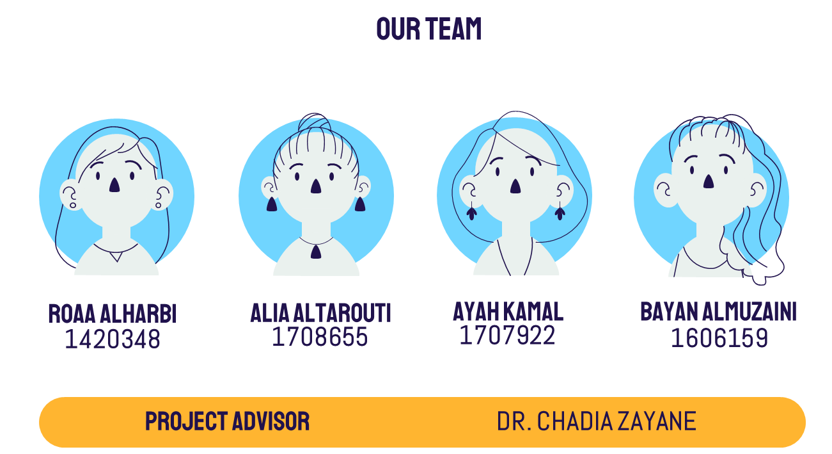
SDVM Mask
FINAL Report
Presentation
Social Distancing and Vital Monitoring Mask
1

Slide 2
Contents
Background
Problem Statement
Objectives of Project
Implementation of Design
Block Diagram/Flowchart
Testing
Final Product
Application
Results and Discussion
Impact of Solutions
Conclusions
References
2

Slide 3
Current situation
1. Background
SOCIAL DISTANCING
Wearing a mask
GETTING VACCINE
TWO meter
Customers
Who?
Citizens of COVID-19 affected countries
What?
Help them live out their day-to-day lives.
3
Notes:
210 countries around the world have reported more than three million infected people including more than two hundred thousand deaths [1]
Current Situation: Washing hands

Slide 4
2. Problem statement
The spreading of the contagious COVID-19 disease worldwide is alarmingly fast, and there are instances of infected individuals showing delayed signs of symptoms.
There are difficulties containing the virus and measures suggested such as social distancing to mitigate the spread
Virus can affect the human body and cause a range of symptoms, in which initial information and evaluation of vital signs regarding a possible infection are crucial
4

Slide 5
3. Objectives of Project
Model the mask structure with a cleanable front material and detachable straps that hold the sensors
To build an application that tracks the users’ vital signs and alarms them of any abnormalities
01
03
05
Design a social distancing and vital signs monitoring lightweight mask.
To measure the user's vital signs (i.e., temperature and oxygen saturation)
To provide warnings to alert the user when another person is too close to maintain proper social distancing
02
04
5

Slide 6
04.
IMPLEMENTATION

Slide 7
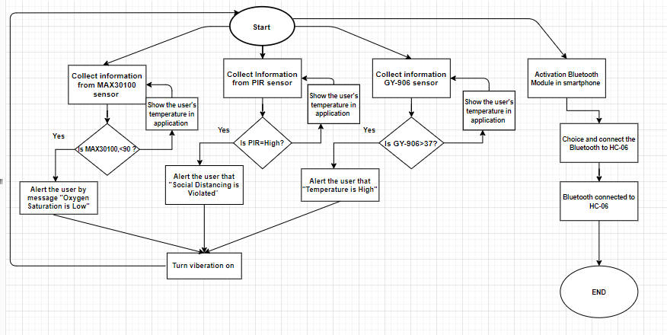
FLOW Chart

Slide 8
Testing Components

Slide 9
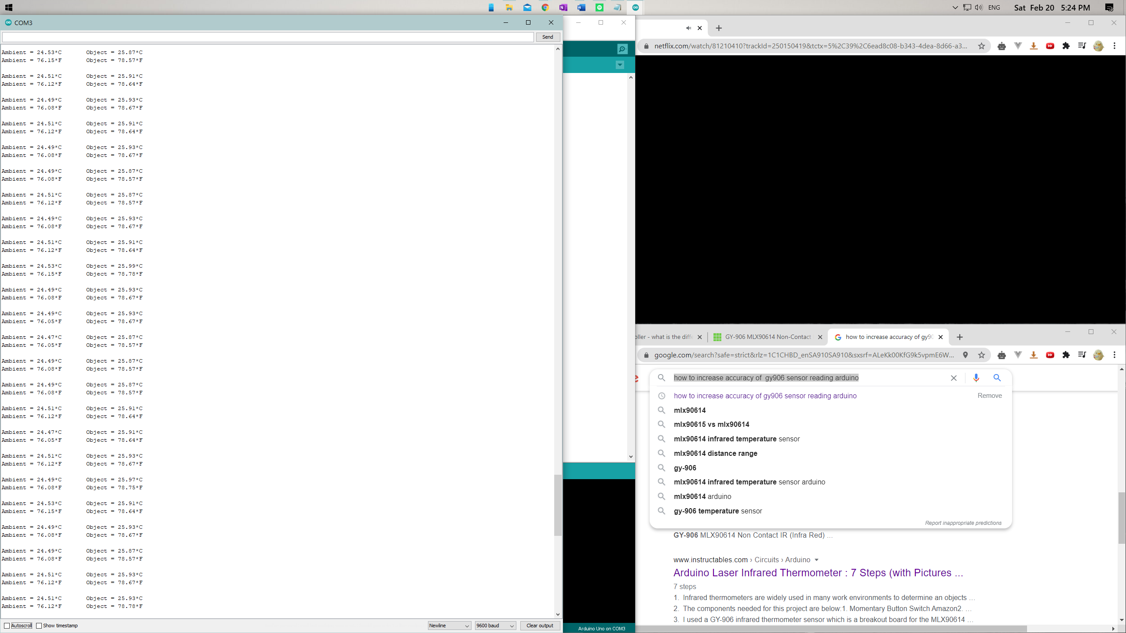
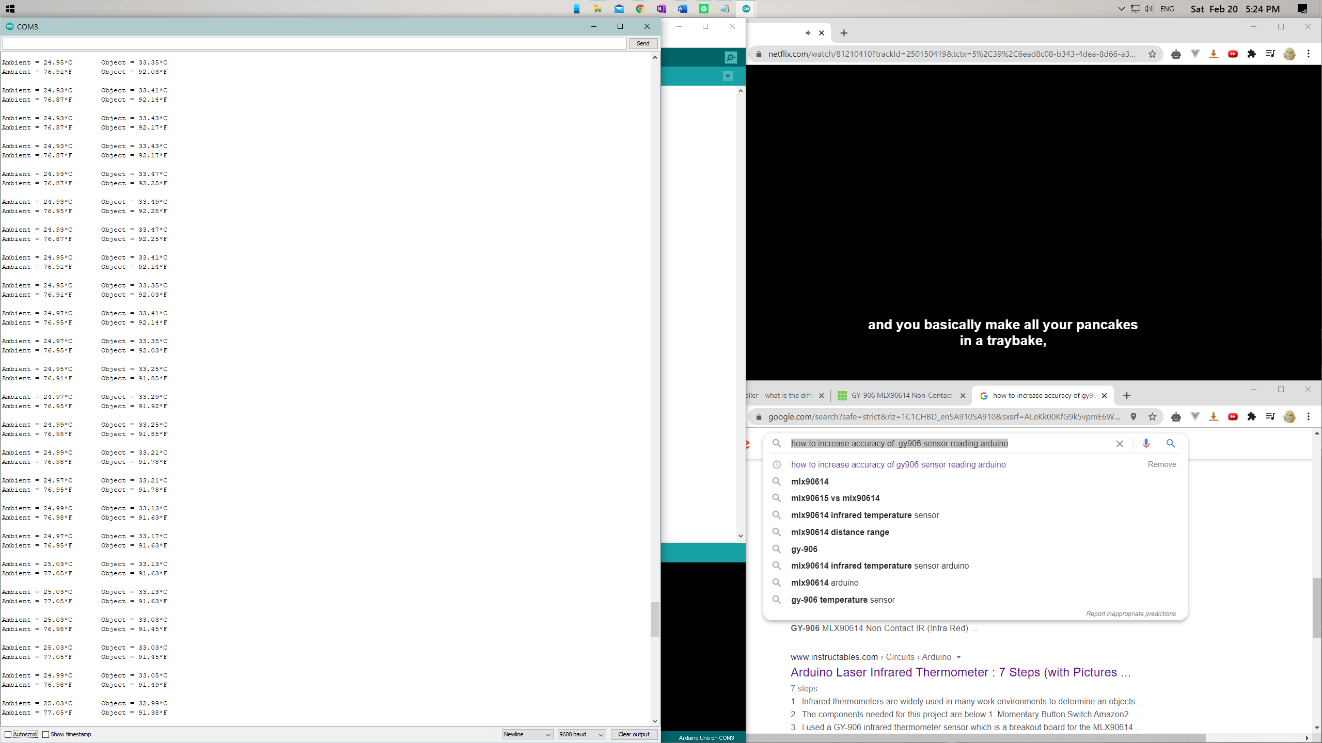

1. Testing GY-906 Sensor

Slide 10
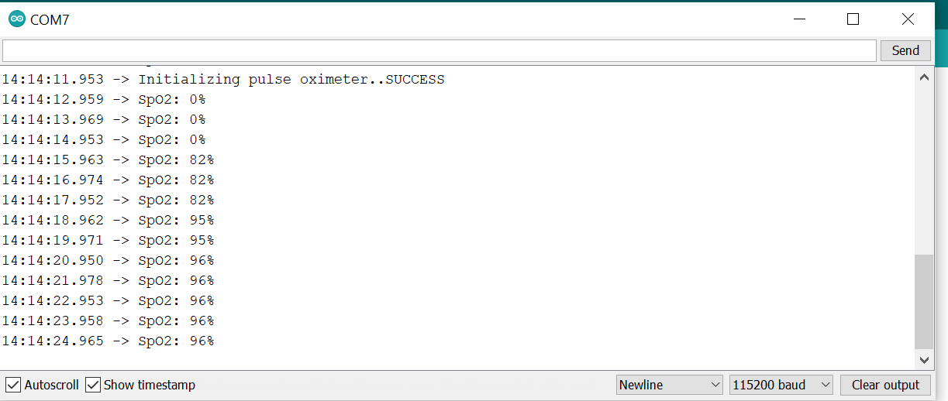
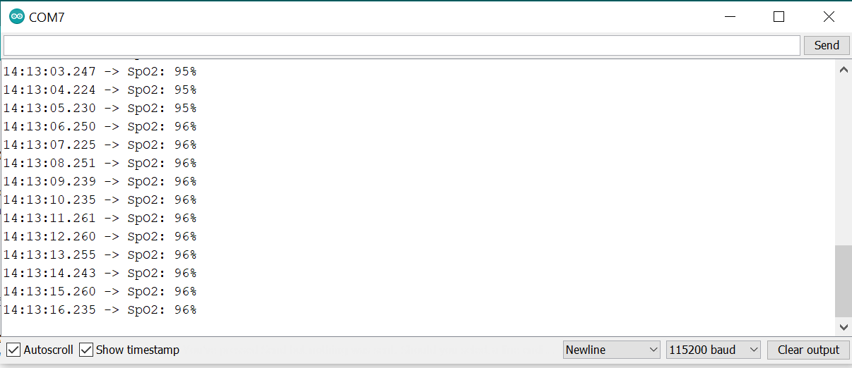
2 . Testing MAX30100 Sensor

Slide 11
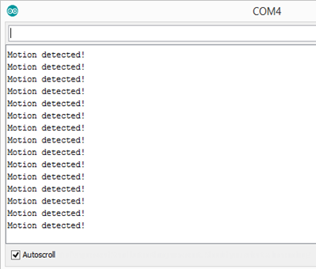
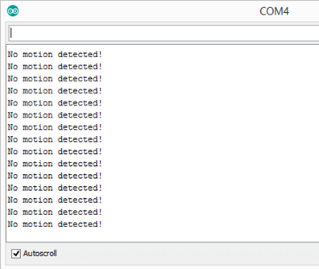
3. Testing PIR Sensor

Slide 12
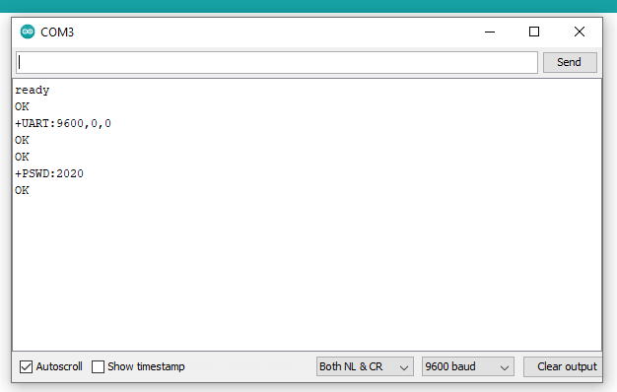
4. Bluetooth Testing

Slide 13
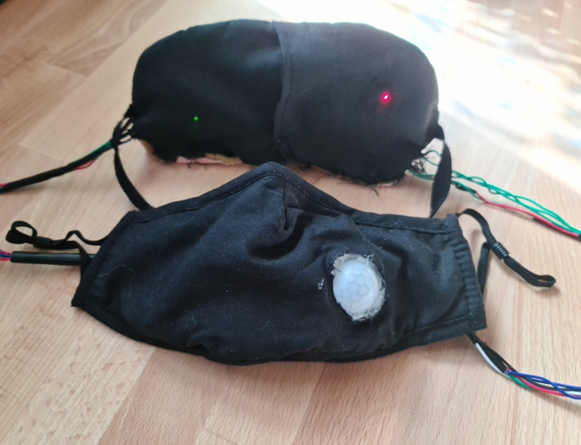
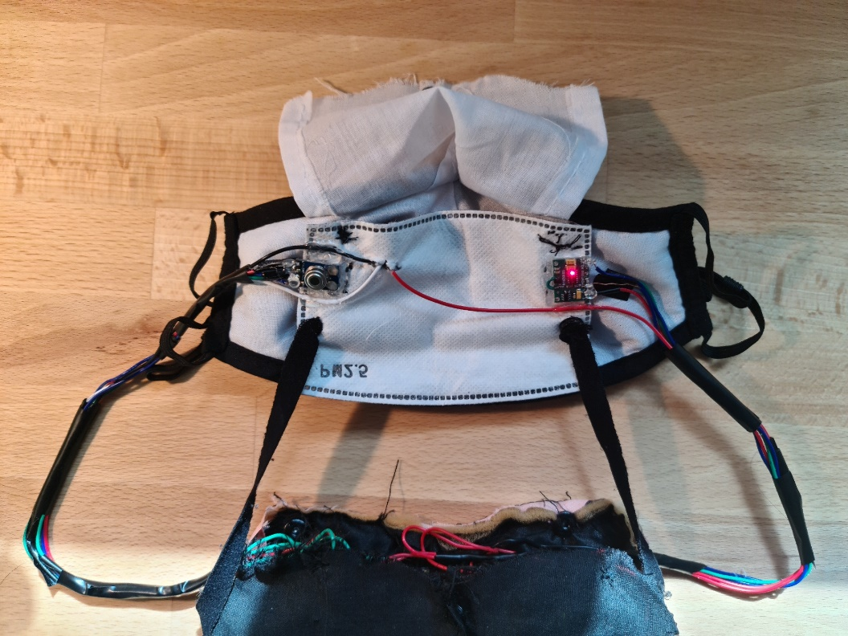
FINAL PRODUCT
Temperature Sensor and Pulse Oximeter on front of mask from inside
PIR Sensor at the front of mask
Notes:
Explain how its worn
Mention that both temperature and pulse oximeter are able to read through cloth covering
PIR: Specific maximum range, which is 2 meters , and angle (<120)

Slide 14
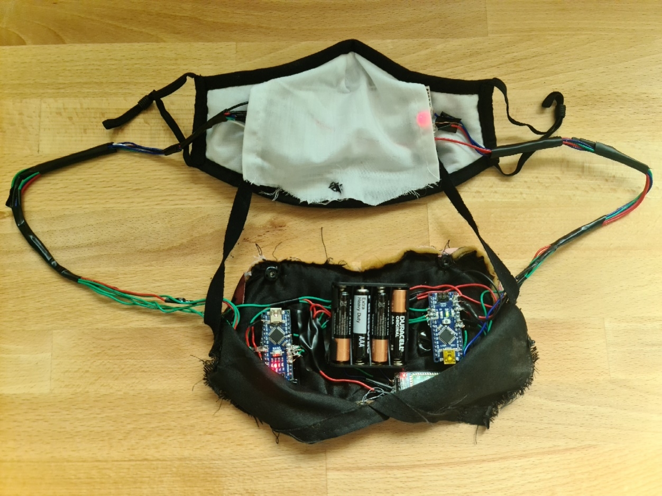
FINAL PRODUCT
Battery, Arduino’s, and Bluetooth Module on back piece.
PIR Sensor at the front of mask
Notes:
Mention reason for two Arduinos in final product.
Whole back piece with straps is detachable so that front material can get cleaned.

Slide 15
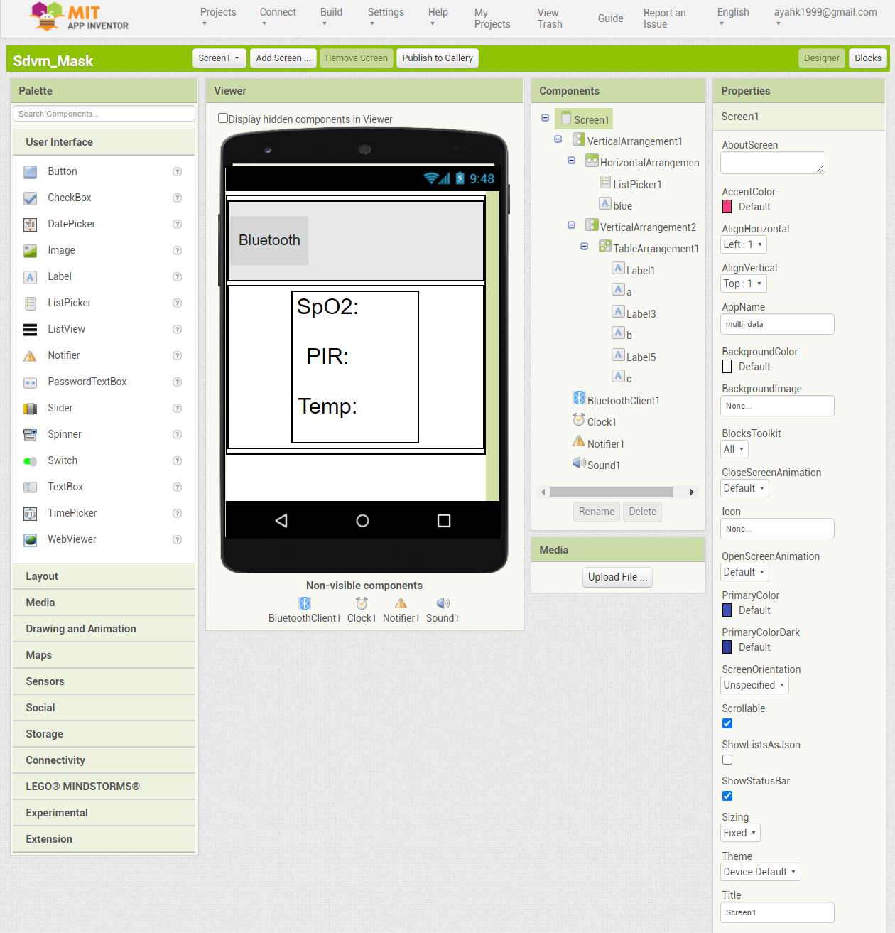
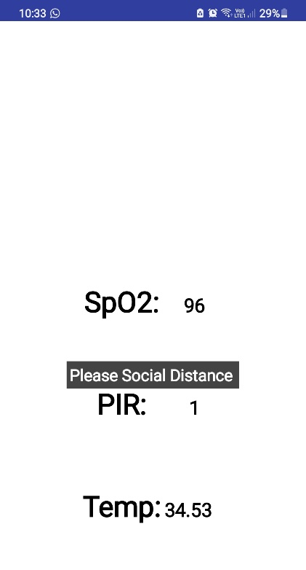
APPLICATION
MIT App Inventor used to build application
Application displays notifications in case:
Temperature is high
Oxygen saturation is low
Social distancing is compromised

Slide 16
05.
Results and discussion
Testing was conducted on 5 different volunteers!

Slide 17
Temperature Sensor Readings
Table – Body temperature measurement results using the MLX90614 sensor
Test Subject | Age | MLX90614 Body Temperature (C) | Thermometer (C) | Difference
Person 1 | 22 | 36.55 | 37.05 | 0.5
Person 2 | 45 | 34.91 | 35.04 | 0.13
Person 3 | 24 | 35.33 | 35.45 | 0.12
Person 4 | 18 | 35.67 | 35.74 | 0.07
Person 5 | 12 | 35.73 | 36 | 0.27

Slide 18
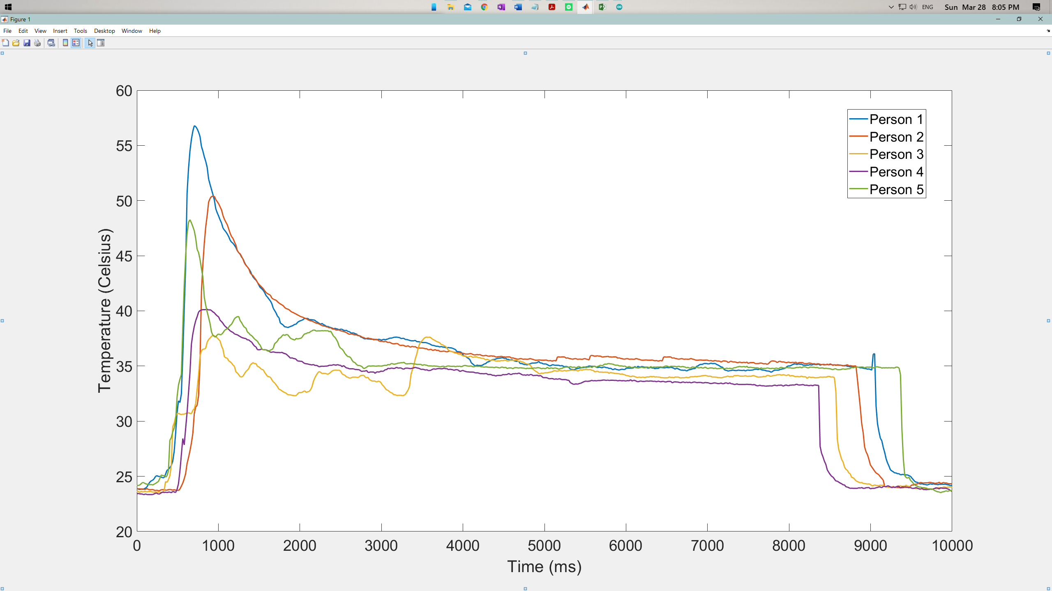
Temperature Sensor Readings
Person 1
Person 2
Person 3
Person 4
Person 5
Reading increase highly and takes from 500 to 1000 milliseconds to be nearly stable!
Figure - Plot of temperature readings for each test subject

Slide 19
Blood Oxygen Saturation Sensor Readings
Table - Oxygen saturation measurement results using the MAX30100 sensor
Test Subject | Age | MAX30100 Oxygen Saturation (%) | Samsung Oxygen Saturation (%) | Difference
Person 1 | 22 | 98 | 98 | 0
Person 2 | 45 | 95 | 99 | 4
Person 3 | 24 | 98 | 98 | 1
Person 4 | 18 | 96 | 98 | 2
Person 5 | 12 | 98 | 99 | 1

Slide 20
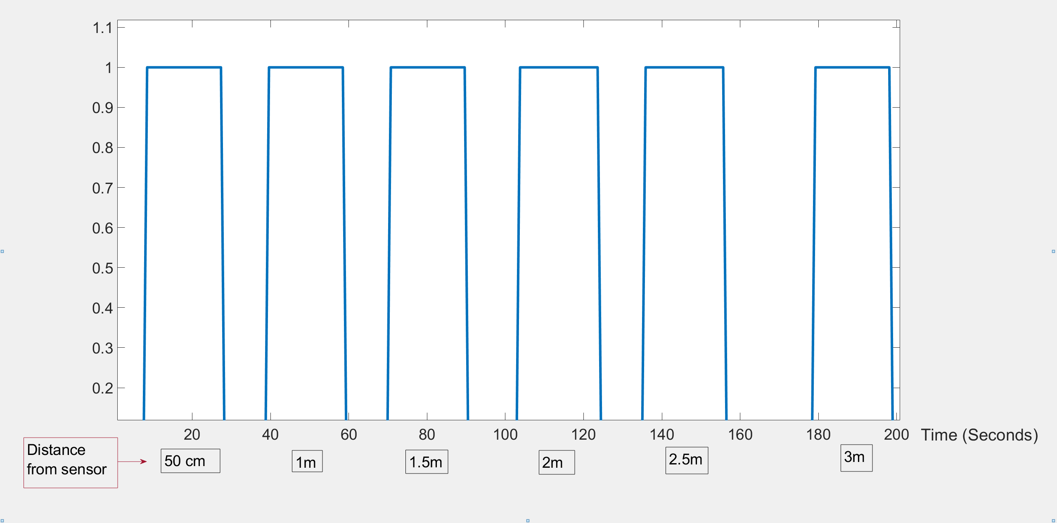
Social Distancing Sensor Readings
The sensor is set to stay at HIGH for 20 seconds as long as the person is still standing in front of the user!
Figure - Plot showing the relation between time and distance for the PIR sensor

Slide 21
EVALUATION OF SOLUTIONS
01
02
03
The SDVM mask is a lightweight disposable mask with a cleanable front material structure
The mask can track the user's social distancing and vital signs.
The mask is provided with an application that tracks the users’ vital signs and warns them of any abnormalities
04
05
The optimal power usage was satisfied
The mask is environmentally friendly

Slide 22
Impacts of solutions
Environmental
Safety
Washable
Recyclable
Reliable power source.
Financial
Social
Decrease the load on the health sector.
Make the routine checkups for healthcare workers more constant and time-efficient.
- Affect the country’s economy positively.

Slide 23
Conclusions
The prototype was able to model the desired outputs of the system and meet customer needs and requirements. The main objectives of the prototype were for it to be able to help the user monitor their vital signs and maintain proper social distancing. The application also serves its purpose in being a user friendly and simple manner.

Slide 24

THANKS!
Do you have any questions?
18

Slide 25
References
 | [1] C. T. Nguyen, "Enabling and Emerging Technologies for Social Distancing: A Comprehensive Survey and Open Problems," p. 43, 2020
 | [2] T. TAMURA, M. HUANG and T. TOGAWA, "Thermometers, Current Developments in Wearable," Advanced Biomedical Engineering, .p. 13, 2018 [3] Y. Khan, A. E. Ostfeld, C. M. Lochner, A. Pierre and A. C. Arias, "Monitoring of Vital Signs with Flexible and Wearable," Advanced Material, 2016. [4] S. Bian, B. Zhou and P. Lukowicz, "Social Distance Monitor with a Wearable Magnetic Field Proximity Sensor," MDPI Open Access Journals, vol. 20, no. 18, p. 5101, September 2020. [5] Z. Wang, Z. Yang and T. Dong, "A Review of Wearable Technologies for Elderly Care that Can Accurately Track Indoor Position," MDPI Open Access Journals, vol. 17, p. 341, 2017. [6] R. Effing, R. J.Brouwer, A. Iliev, T. Teunissen and F. Wijnhoven, "WHERE TO GO? SMART GUIDANCE BASED ON IOT SENSOR-DATA," International Conference ICT, Soceity, and Human Beings, 2020. [7] A. Alarifi, "UltraWideband Indoor Positioning Technologies: Analyis and Recent Advances," MDPI Open Access Journal, vol. 16, p. 707, 2016. [8] C. T. Nguyen, "Enabling and Emerging Technologies for Social Distancing: A Comprehensive Survey and Open Problems," p. 43, 2020. [9] E. Chapin, "University of Kentucky, College of Engineering," 14 May 2020. [Online]. Available: https://www.engr.uky.edu/research-faculty/research/2020/developingmask-captures-and-deactivates-covid-19-dibakar. [Accessed 5 October 2020].
19

Slide 26
References
 | [10] S. Kelly, "Cornell Chronicle," 6 May 2020. [Online]. Available: https://news.cornell.edu/stories/2020/05/student-team-designs-smart-mask-monitorsvital-signs. [Accessed 5 October 2020]. [11] A. Bendix, "Business Insider," 13 May 2020. [Online]. Available: https://www.businessinsider.com/coronavirus-face-mask-light-up-screening-tooltest-2020-5. [Accessed 5 October 2020]. [12] "Carebook," [Online]. Available: https://carebook.com/my-vitals-covid-19/. [Accessed 13 October 2020]. [13] C. Criddle, "BBC Tech," 9 September 2020. [Online]. Available: https://www.bbc.com/news/technology-54091539. [Accessed 6 October 2020].
20

